Slide 1
Extreme heat in Oregon
Dan Rubado, MPH
Epidemiologist
Office of Environmental Public Health
Notes:
The project I’m going to talk about today grew out of a Public Health Division workgroup on climate change data and surveillance that was started about a year ago.
A number of us from the OEPH and the Office of Disease Prevention and Epidemiology have been participating in this workgroup and collaborated on this project together.
We had additional input on this project from Alexis Dinno at PSU School of Community Health and Kathie Dello at OSU’s Climate Change Research Institute.

Slide 2
700
documented heat-related deaths in the US per year*
*more than all other weather-related deaths combined
Notes:
Here are some basic heat waves stats for the united states…
There are about 700 heat-related deaths in the US per year.
Young children and older adults (65 years and above) are at especially high risk of heat related illness.
Let’s take a look at some examples of the impact of major heat waves.

Slide 3
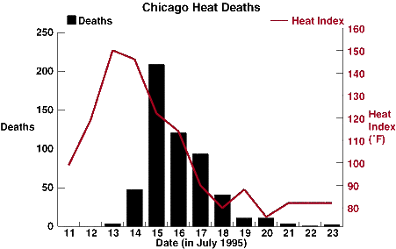
1995 Chicago heat wave
5 days above 100°F apparent temperature
739 deaths
1,072 hospitalizations
3,300 ED visits
14.6 heat-related death rate ratio for adults 65+
Notes:
The 1995 Chicago heat wave was a long period of elevated heat and humidity during July.
Five days from July 12 – 16 had day time maximum apparent temperatures above 100 degrees.
This was accompanied by high night time temperatures and humidity, providing little cooling or relief from the heat.
There were an estimated 739 excess deaths, 1072 excess hospital admissions and 3300 excess emergency department visits attributed to the heat wave.
Adults 65 and older were 14.6 times more likely to die of heat-related illness during the heat wave than younger people.

Slide 4
2006 California heat wave
11 consecutive days above 100°F
655 deaths
1,182 hospitalizations
16,166 ED visits
Notes:
The 2006 California heat wave, from July 16-26, reached across the entire state and much of the Western US.
This heat wave set a number of climate records for maximum temperatures and duration of high temperatures.
Several cities recorded 11 consecutive days with temperatures above 100 degrees.
The high day time temperatures were accompanied by high night time temperatures as well.
In California, there were an estimated 655 excess deaths, 1182 excess hospitalizations and 16,166 ED visits attributed to the heat wave.

Slide 5
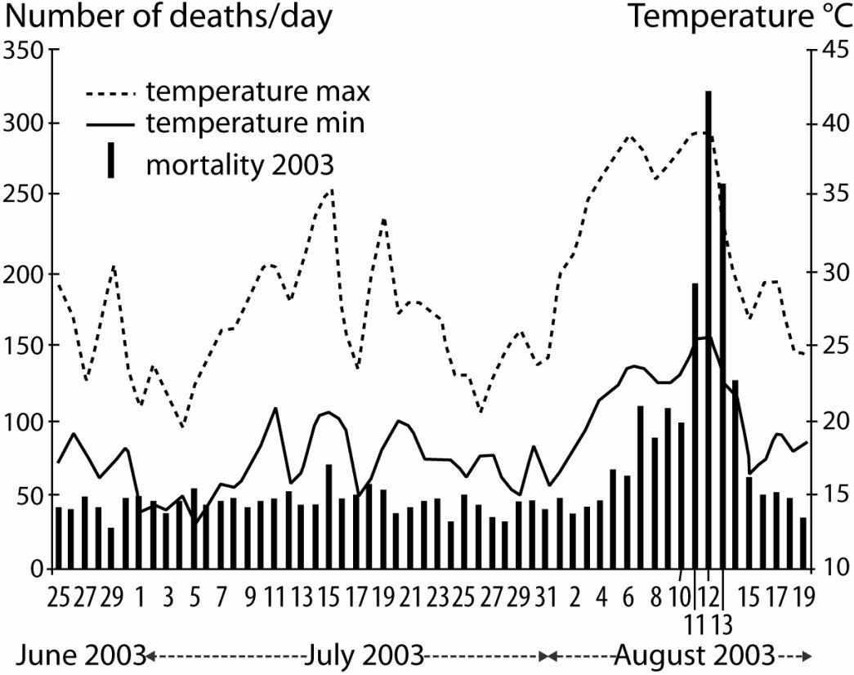
2003 heat wave in France
Hottest summer in Europe in the last 500 years
15 consecutive days over 95°F
14,800 deaths
4.4 relative risk of heat-related death with no AC
Notes:
During a 16 day period in early August, Europe experienced an extreme heat wave making it the hottest summer in 500 years.
In France, temperatures were above 95 degrees during the day and 68 degrees at night for 15 consecutive days with the hottest days reaching 104 degrees.
Across the continent, an there were an estimated 40,000 excess deaths attributed to the heat wave.

Slide 6
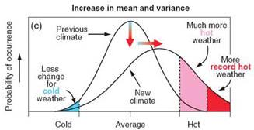
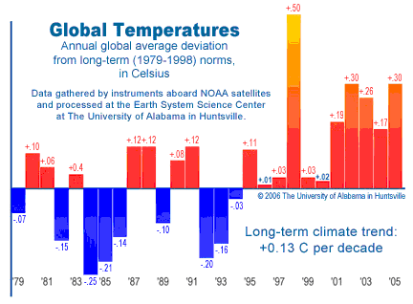
impacts of climate change
average summer time heat-related deaths are projected to increase, with larger increases in mid-latitude cities.
Notes:
Climate change models show that there will be a steady increase in summertime temperatures in this century.
Indeed, according to NASA, 2000-2009 was the hottest decade on record.
Projections also show an increase in both the frequency and intensity of heat waves in the US.
A number of studies have estimated that heat-related deaths will likely increase dramatically in cities across the country along with the increases in summertime temperatures.
These will not be balanced out by decreases wintertime deaths due to decreased cold.
Heat related death increases will be even larger in mid-latitude cities with greater climate variability.

Slide 7
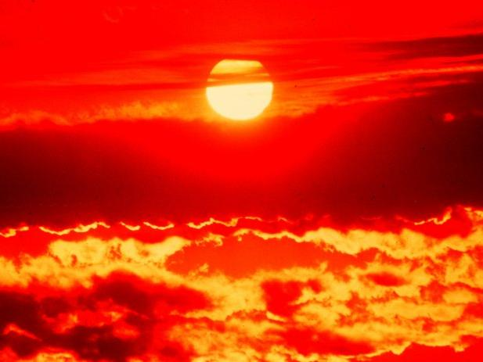
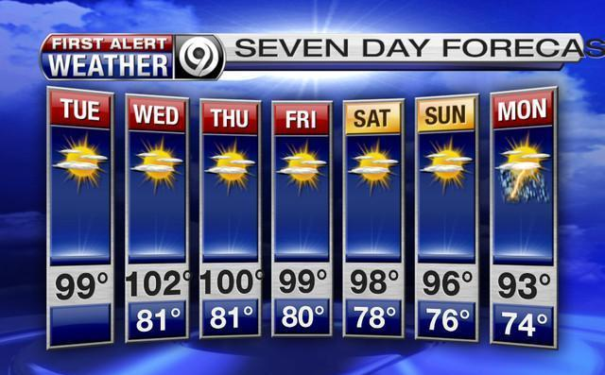
oh no!
are we headed for a fiery future of endless heat waves?
Notes:
Are we headed for a fiery future of endless heat waves?
Oregon certainly seems to have seen a fair share of hot weather.
But what is going to happen here in the future?
How hot does it really get here?
And how much of an effect does heat have on the health of Oregonians?
How hot does it have to get before we start to see increases in morbidity and mortality?
These are the questions that we set out to answer.

Slide 8
statewide climate statistics
77°F average day time high temperature
50°F average night time low temperature
37.2 average number of days above 85°F
1.7 average number of days above 100°F
110°F highest average temperature in the state
Notes:
Let’s do a quick review of some of the climate statistics that we calculated for this study…
Across the state from 2000-2009 we looked at temperatures from May through September…
The average warm season day time high was 77 degrees with half of days registering from 69 to 85.
The highest temperatures were around 110 degrees.
The average night time low temperature was 50 degrees during the summer with a typical range of 46 to 55.
The highest night time average temperature was around 79 degrees.
On average, the state saw 37.2 days per year above 85 degrees and 1.7 days above 100 degrees.
Well, it definitely gets hot sometimes, but it doesn’t seem too bad so far.
These are just averages and there are substantial variations regionally and from year to year.

Slide 9
statewide heat-related illness stats
33.3 heat-related hospitalizations per year
1.8 heat-related deaths per year
compared to:
111,277 total hospitalizations per year
11,300 total deaths per year
Notes:
Statewide, on average…
There are 33.3 hospital admissions per year documented as environmental heat-related illnesses in the diagnostic codes.
There are 1.8 deaths per year with the cause of death or contributing factor listed as environmental heat.
Compare this to an average of 111,277 total non-injury hospitalizations per year and 11,300 non-injury deaths per year and heat-related illness doesn’t seem like much of an issue in Oregon.
However, it is well documented that heat-related hospital admissions and deaths are dramatically under-reported, so what we really need to do is to investigate excess hospitalizations and deaths attributable to heat.
Also, these are statewide averages, which can hide a lot of spatial and temporal variation.
Let’s take a closer look…

Slide 10
coastal region
68°F average day time high temperature
49°F average night time low temperature
1.1 average number of days above 85°F
0 average number of days above 100°F
96°F highest average temperature
Coos Bay climate normals
Notes:
We broke the state into four climate regions for analysis.
The coastal region included everything from the crest of the coast range to the Pacific.
On the Oregon coast, from 2000-2009…
The average summer day time high was 68 degrees with a typical range of 64 to 71.
The highest daily average temperature was around 96 degrees.
The average night time low temperature was 49 degrees during the summer with a typical range of 46 to 52.
On average, the coastal region saw 1.1 days above 85 degrees and 0 days above 100 degrees.

Slide 11
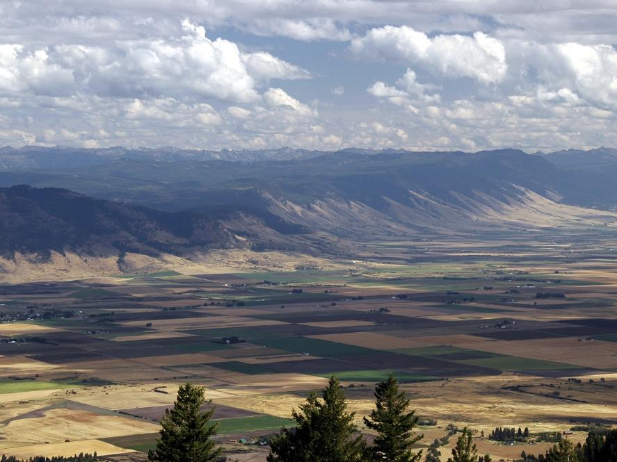
eastern region
80°F average day time high temperature
46°F average night time low temperature
56.5 average number of days above 85°F
1.9 average number of days above 100°F
108°F highest average temperature
La Grande climate normals
Notes:
The eastern region included everything east of the crest of the cascades.
In Eastern Oregon, from 2000-2009…
The average summer day time high was 80 degrees with a typical range of 72 to 88.
The highest daily average temperature was around 108 degrees.
The average night time low temperature was 46 degrees during the summer with a typical range of 40 to 52.
On average, the eastern region saw 56.5 days above 85 degrees and 1.9 days above 100 degrees.

Slide 12
southwest region
82°F average day time high temperature
49°F average night time low temperature
69.8 average number of days above 85°F
4.8 average number of days above 100°F
110°F highest average temperature
Medford climate normals
Notes:
The southwest region included everything from the coast range to the crest of the cascades south of Lane County.
In the southwest region, from 2000-2009…
The average summer day time high was 82 degrees with a typical range of 75 to 90.
The highest daily average temperature was around 110 degrees.
The average night time low temperature was 49 degrees during the summer with a typical range of 45 to 54.
On average, the southwest region saw 69.8 days above 85 degrees and 4.8 days above 100 degrees.
That makes the southwest the most consistently hot region of the state.

Slide 13
Willamette valley region
77°F average day time high temperature
51°F average night time low temperature
32.7 average number of days above 85°F
1.3 average number of days above 100°F
108°F highest average temperature
Corvallis climate normals
Notes:
The Willamette valley region included everything from the coast range to the crest of the cascades from Lane County north.
In the Willamette valley, from 2000-2009…
The average summer day time high was 77 degrees with a tyipcal range of 70 to 84.
The highest daily average temperature was around 108 degrees.
The average night time low temperature was 51 degrees during the summer with a typical range of 47 to 56.
On average, the Willamette valley saw 32.7 days above 85 degrees and 1.3 days above 100 degrees.

Slide 14
working hypothesis
high summer temperatures are associated with modest increases in deaths and hospital admissions, associations that vary regionally.
research questions
what are the effects of heat on different health outcomes in Oregon?
how hot does it have to get before we see big increases in heat-related illness?
how do these effects vary regionally and for vulnerable age groups?
Notes:
So heat certainly varies dramatically across the state, but what about health outcomes associated with heat?
We decided to look a little closer…
Based on previous research from around the world, our hypothesis was that high summer temperatures would be associated with modest increases in deaths and hospital admissions and that these associations would vary regionally.
So, we set out to answer these questions:
What are the effects of heat on different health outcomes in Oregon?
What range of temperatures is most dangerous to human health?
How do these effects vary regionally and for vulnerable populations?

Slide 15
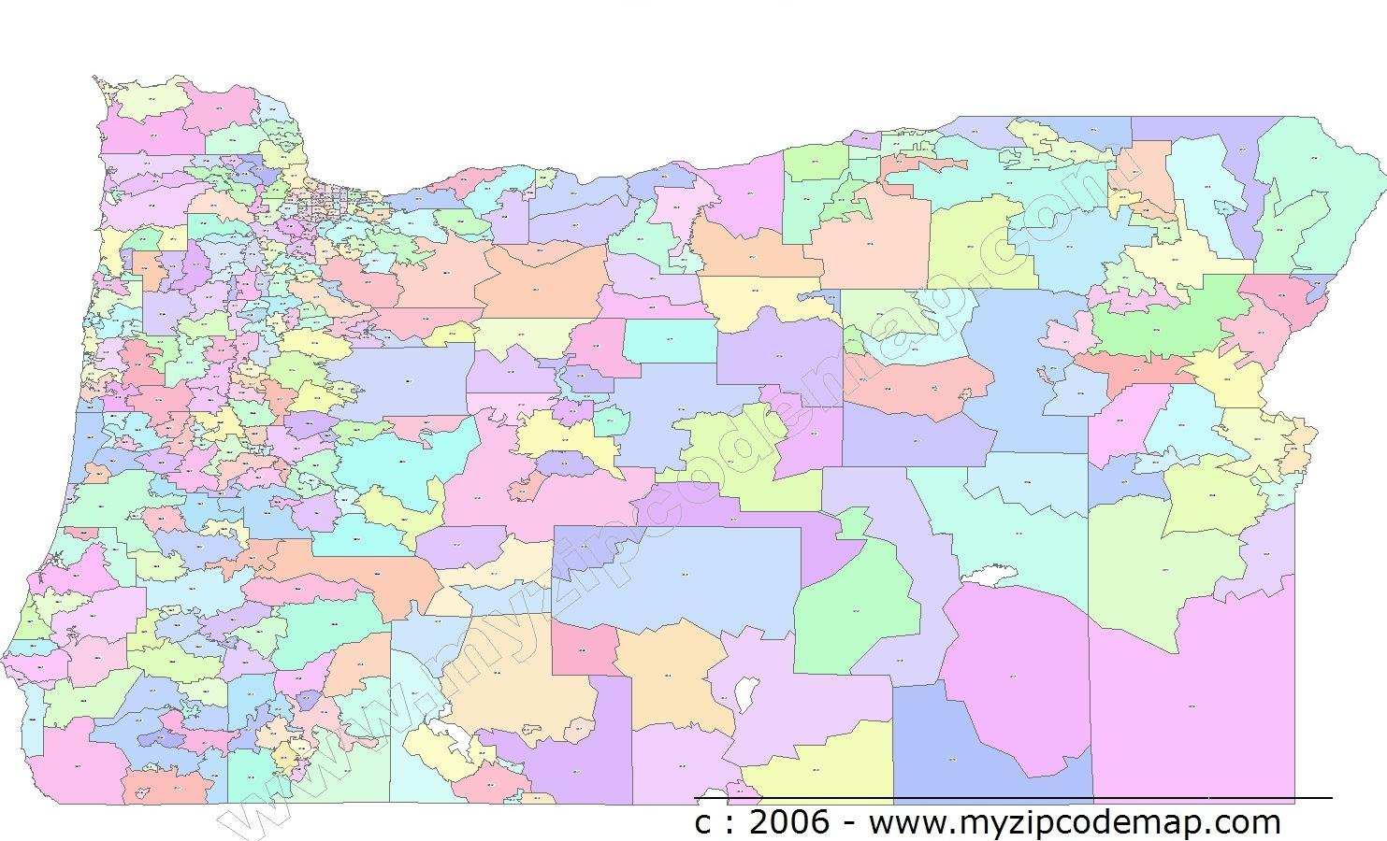
Oregon zip codes
daily mortality counts
daily hospital admission counts
Census zip code population estimates
weather station data
zip code boundary
weather station
weighted average: selected stations
daily max temp
daily min temp
population weighted center
d3
d1
small town
big town
d2
w1 = 1 - d1/(d1 + d2)
geographic center
w2 = 1 - d2/(d1 + d2)
N
4 miles
Notes:
We started by gathering up a number of data sets and calculating daily zip code level statistics.
We used the year 2000 zip code boundaries and created a look-up table to attribute post-2000 zip codes to their 2000 equivalents.
Daily hospital admission counts by zip code for 2000-2009
Daily mortality counts by zip code for 2000-2009
Census block population counts apportioned to zip code by year from 2000-2009.
The weather station data had to be attributed to the zip codes.
It included latitude and longitude, elevation, and daily maximum and minimum temperatures
We first calculated the population weighted centroids for each zip code.
Then we selected the two nearest weather stations within a 20 mile radius of each centroid.
The distance and elevation difference between each station and the centroid were used to calculate weighted averages for daily maximum and minimum temperatures.

Slide 16
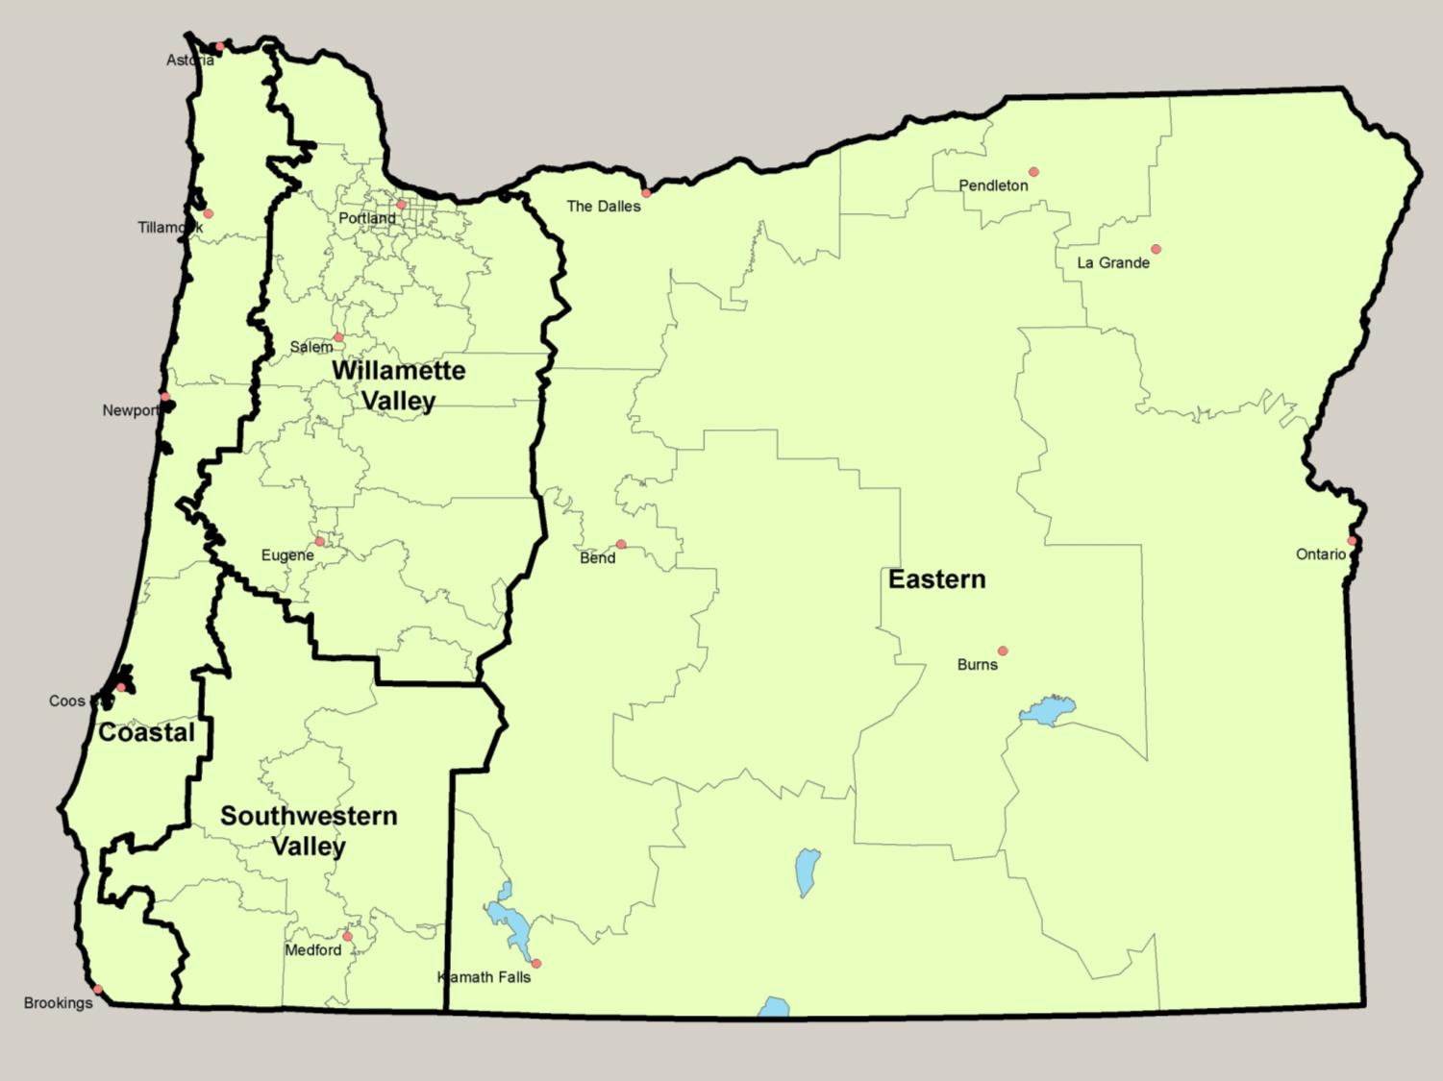
Notes:
These are the climate regions that we created, based on NOAA climate divisions but collapsed into 4 areas that had relatively homogeneous climates.
We had to aggregate zip codes within each region to create areas with large enough populations for analysis; about 30,000 residents.
The average population per aggregated area was 42,421 with a range from 16,496 to 84,040.
At this point, we were ready to begin the analysis…

Slide 17
analysis methods
Poisson regression model:
log(count) = log(population) + α + β(predictor)
outcome variables
heat-related hospitalizations
heat-related deaths
predictor variables
temperature variables and climate region
Notes:
In order to test the relationships between climate variables and health outcome counts, I used a Poisson general linear model through the genmod procedure in SAS.
Census-derived population values were used as the offset term so that we were modeling rates instead of straight counts.
I began by building models using our most specific outcomes: heat-related hospital admissions and deaths. For these, I knew that essentially all cases were associated with heat, so I was able to assess the association more simply without controlling for a lot of additional factors.
I then added a whole host of predictor variables, including maximum and minimum temperature, to test against these outcomes.
Climate region was added to the model to distinguish the effects between regions.
After I built models using the heat-related outcomes, I tested other outcomes, using the models as a starting point.

Slide 18
initial results
significant predictors:
maximum temperature
minimum temperature
r = 0.49
p = <0.0001
Max temp
Min temp
outcome | predictor | rate ratio (95% CI) | p-value
heat-related hospitalizations | max temp | 3.66 (3.18, 4.22) | <0.0001
 | min temp | 1.37 (1.12, 1.68) | 0.0019
age 0-4 heat-related hospitalizations | max temp | -- | --
 | min temp | -- | --
age 65+ heat-related hospitalizations | max temp | 3.79 (3.15, 4.56) | <0.0001
 | min temp | 1.33 (0.98, 1.80) | 0.0648
Notes:
For heat-related hospitalizations, the predictor variables that came out on top were the most simple, maximum and minimum temperature. There were too few heat-related deaths to create a valid model for that outcome.
Max and Min temperature have significant correlation, so there may be some issues with colinearity in the model.
Maximum temperature appears to be the stronger predictor of the two.
Unfortunately, the model fit was not that good, probably because of how sparse the data were. Recall that there are only about 33 of these events per year in the state.
The model tends to underestimate the variability and risk, so it provides conservative estimates.
For all ages, a 10 degree increase in maximum temperature was associated with a 270% increase in the rate of heat hospitalizations.
A 10 degree increase in minimum temperature was associated with a 37% increase in the rate of heat hospitalizations.
For the 0-4 age group, there were too few events to create a valid model.
For ages 65 and over, the associations were essentially the same, but minimum temperature was not significant.
Next, we’ll take a look at the predicted values versus the maximum temperature for each region.

Slide 19
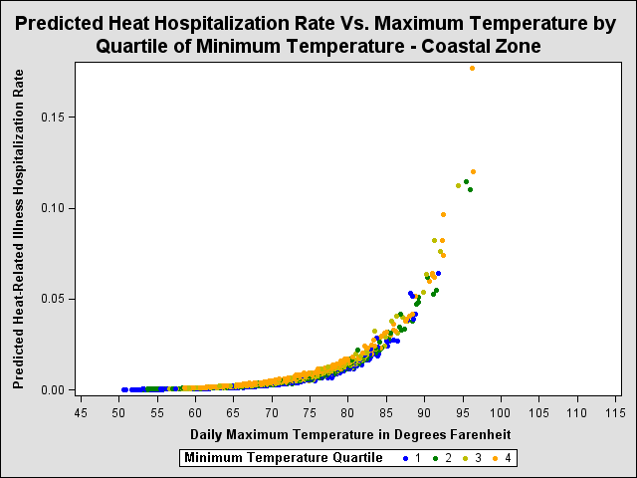
coastal
Notes:
This graph shows the predicted heat-related hospitalization rate for the coast region versus the daily maximum temperature.
You can see that from 50-70 degrees, the rate is essentially zero, but then begins to climb steadily above 80 degrees. The curve is increases rapidly by the time the temperature hits 90, however, in absolute terms, the rates are still quite low (about 1 per million population per day at 95 degrees)

Slide 20
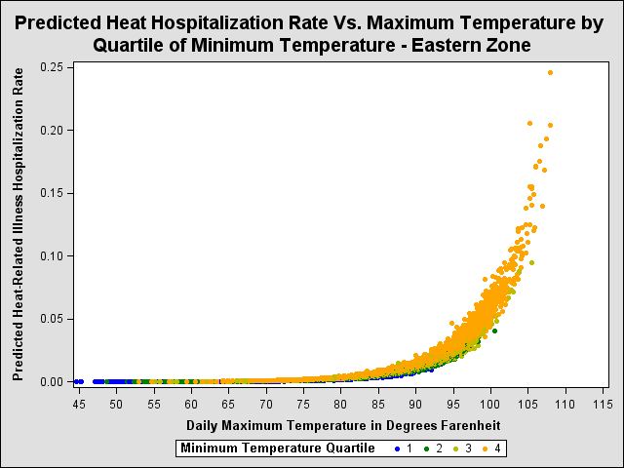
eastern
Notes:
Here we see the predicted rate for eastern oregon versus the maximum temperature.
As you can see the curve is substantially shifted to the right and we don’t see much of an increase in the rate until about 90 degrees. The predicted rate doesn’t hit 1 per million per day until over 100 degrees.

Slide 21
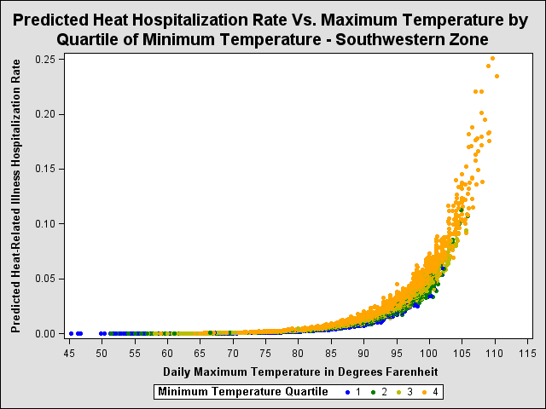
southwestern
Notes:
This is the graph for southwestern Oregon.
The predicted rates form a similar curve to that of Eastern Oregon, perhaps shifted slightly further to the right. The predicted rate hits one in million at nearly 105 degrees.

Slide 22
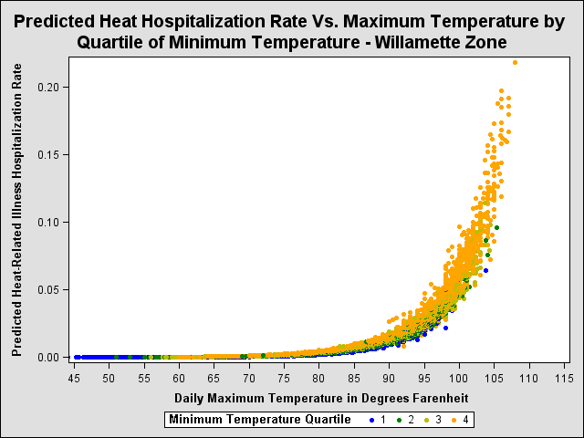
willamette
Notes:
Here is the curve for the Willamette valley.
It is shifted to the left a bit compared to eastern and southeastern oregon.
The rate appears to be rising quickly by the time the maximum temperature hits 100 and hits 1 per million quickly after that.

Slide 23
Notes:
We also evaluated a number of maximum and minimum temperature thresholds to see if we could hone in on a particular range of temperatures that had the biggest impact on health.
These graphs show the predicted rate ratio for a number of temperature thresholds.
There isn’t a really clear message here, but you can see a trend, and maximum temperatures of 100 or greater and minimum temperatures of 65 or greater show significant increases in the rate ratio over lower temperatures.

Slide 24
additional outcomes
hospitalizations
all non-injury
electrolyte imbalance
nephritis
kidney failure
cerebrovascular disease
cardiovascular disease
myocardial infarction
respiratory illness
asthma
deaths
all non-injury
cardiovascular disease
respiratory illness
Notes:
We explored a number of additional outcomes as well, to see if we would find associations with diagnoses that can be caused by heat-related illness. We also looked at all non-injury hospitalizations and deaths to see if we could gauge the overall effect on morbidity and mortality as has been done elsewhere.
Since these outcomes are much less specific, in order to factor out influences other than heat, we used a number of control variables, mostly aimed at removing the strong temporal trends from hospital admissions and deaths that are not related to heat.
These included day of the week, day of the year, month, year,
We also investigated controlling for ozone levels using the EPA’s modeled ozone data, but given the high correlation between ozone and temperature and that ozone levels high enough to impact human health are extremely rare in Oregon, we decided that this was not necessary.

Slide 25
findings
significant associations
all non-injury hospitalizations and deaths
electrolyte imbalance hospitalizations
nephritis hospitalizations
kidney failure hospitalizations
significant heat variables
maximum temperature
minimum temperature (not deaths)
Notes:
We saw significant associations between maximum and minimum temperatures and non-injury hospitalizations, electrolyte imbalance, nephritis and kidney failure hospitalizations.
Non-injury deaths also had a significant association with maximum temperature but not minimum.
None of the models we tested for the 0-4 age group produced significant results, likely because the numbers of events were too small. Associations for adults 65 and over were generally very similar with slightly larger magnitudes than the general population.

Slide 26
findings
outcome | predictor | adjusted rate ratio (95% CI) | p-value
all non-injury hospitalizations | max temp | 1.009 (1.006, 1.011) | <0.0001
 | min temp | 0.992 (0.987, 0.997) | 0.0011
Age 65+ non-injury hospitalizations | max temp | 1.012 (1.007, 1.018) | <0.0001
 | min temp | 0.987 (0.979, 0.995) | 0.0011
electrolyte hospitalizations | max temp | 1.056 (1.034, 1.077) | <0.0001
 | min temp | 1.047 (1.002, 1.094) | 0.0392
all non-injury deaths | max temp | 1.009 (1.001, 1.017) | 0.0231
Notes:
This table shows the rate ratios from a few of the models.
For all non-injury hospital admissions we saw a very small increase of 0.9% for each 10 degree increase in maximum temperature.
The association was reversed from what we expected for minimum temperature with a 0.8% decrease in hospitalizations for each 10 degree increase.
The effects were very similar but slightly larger for older adults.
For electrolyte imbalances, there was a much larger 5.6% and 4.7% increases for every 10 degree increase in maximum and minimum temperatures, respectively.
Nephritis and kidney failure, which can be viewed as more severe manifestations of electrolyte imbalance, had similar but slightly smaller magnitudes.
For all non-injury deaths, we found a very similar association with maximum temperature as we found with non-injury hospitalizations… a 0.9% increase in the rate for every 10 degree increase in temperature.

Slide 27
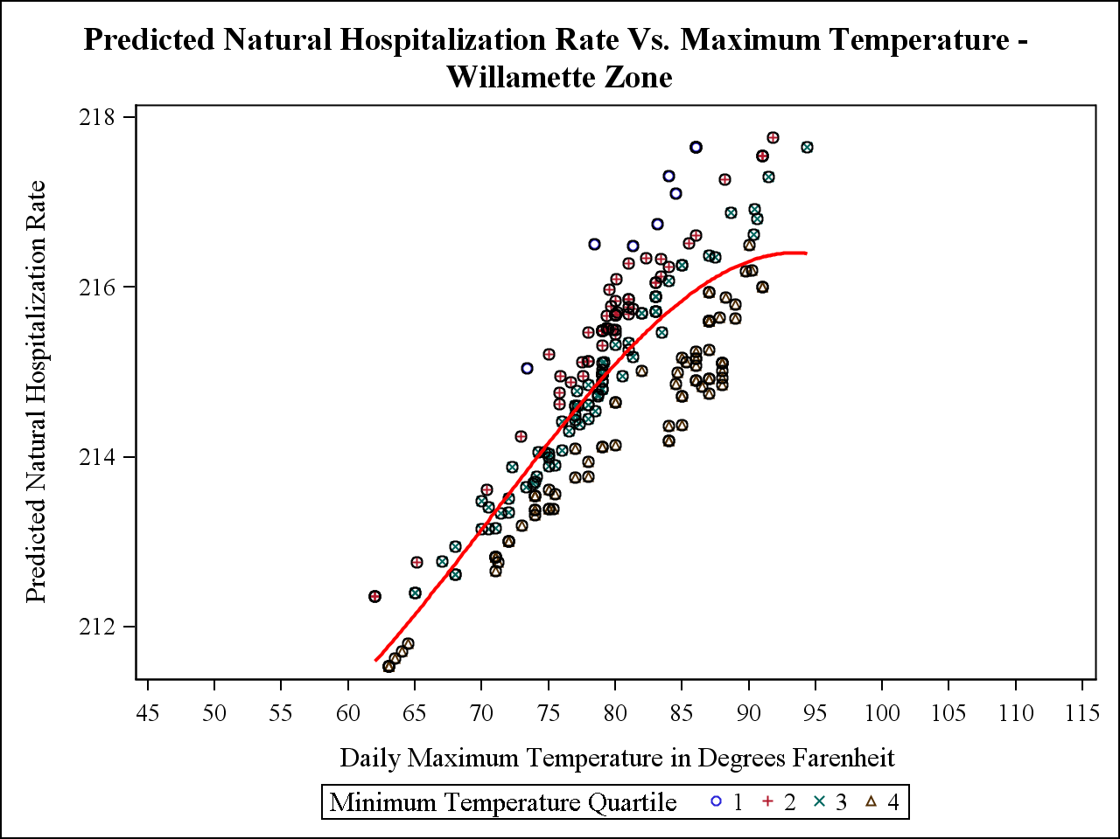
all non-injury hospitalizations
Notes:
There is a definite linear relationship between the predicted rate of non-injury hospitalizations and maximum temperature, but no clear threshold where we see a large increase in risk.

Slide 28
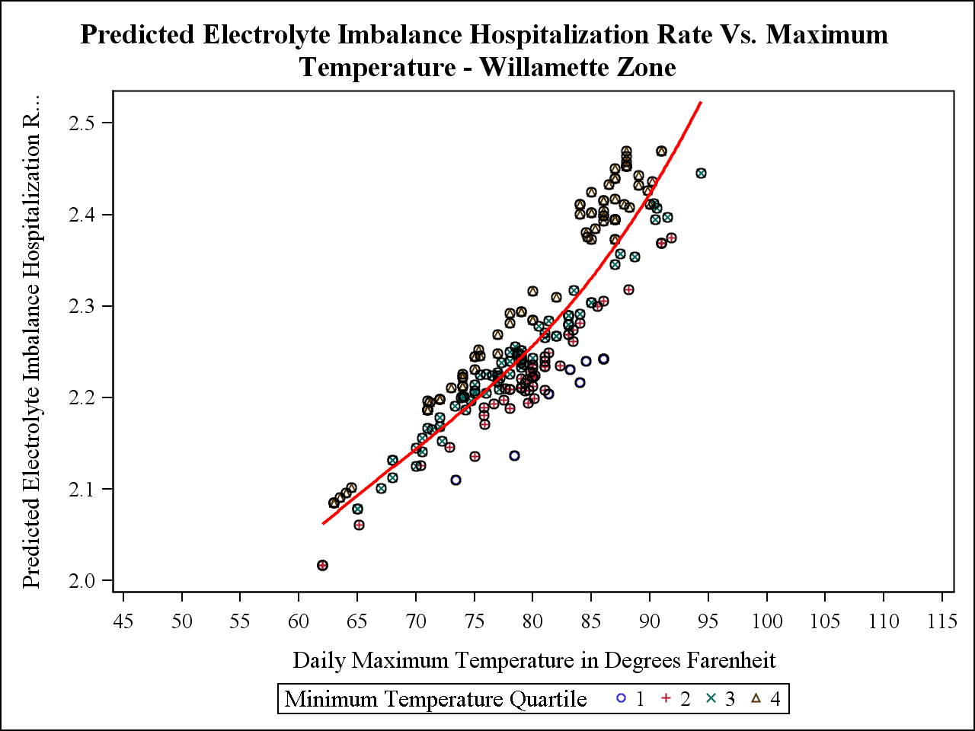
electrolyte imbalance hospitalizations
Notes:
Again, we see a nice positive association between electrolyte imbalance hospitalizations and maximum temperature, but no real threshold effect.

Slide 29
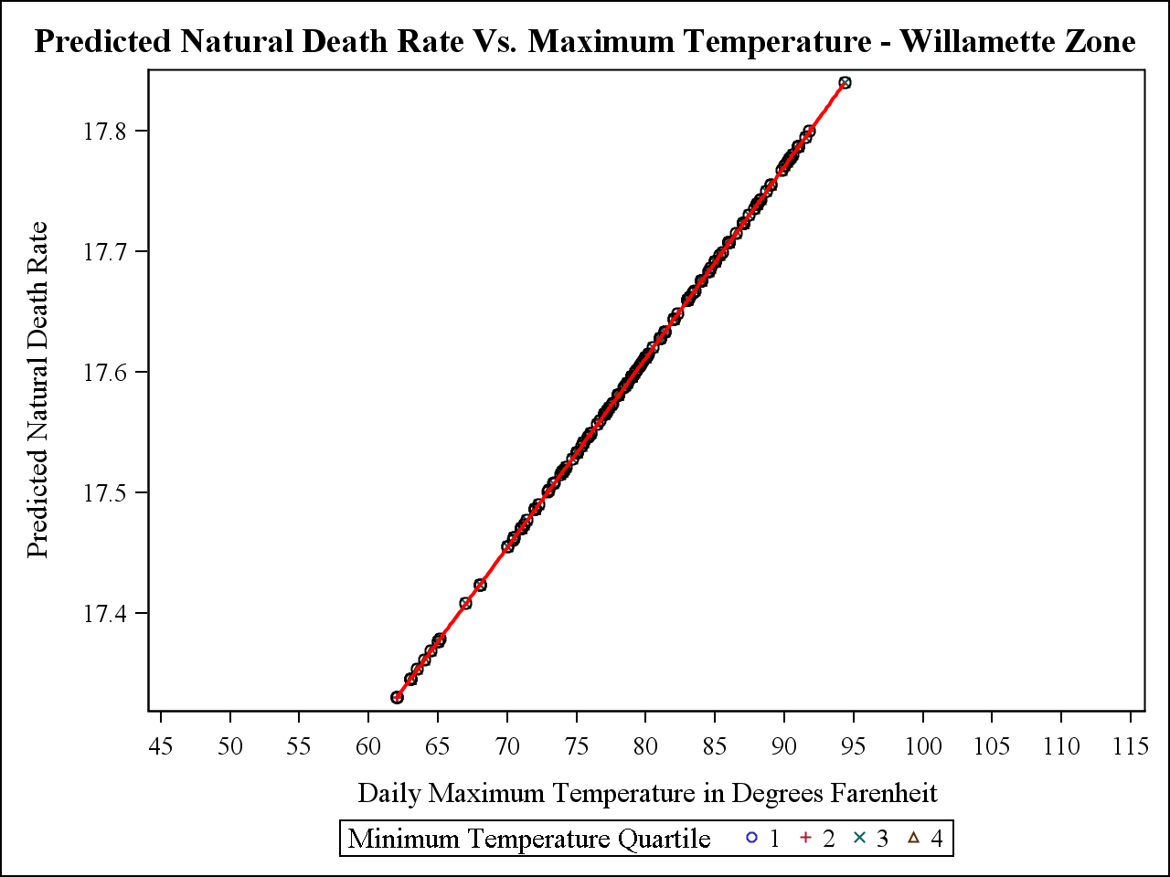
all non-injury deaths

Slide 30
Notes:
Electrolyte imbalance hospitalizations was probably the most interesting association b/c it showed strong, consistent associations, there were a large number of events and it can plausibly be induced by excess heat.
Here we see the rate ratio of electrolyte imbalance hospitalization for a number of temperature thresholds, first for maximum temperature and then for minimum temperature.
These graphs show a clear dose response pattern with heat that seems to take off at about 100 degrees maximum temperature and 65 degree minimum temperature.

Slide 31
summary
heat is not a major health issue in Oregon...
there is an association between heat and illness that varies by region
there are more heat-related deaths and illnesses than reported
significant health effects may occur below what the weather service uses to issue heat advisories
impacts were slightly greater on the 65+ age group
contrary to popular belief, it does get hot in Oregon
with climate change, more hot weather is on the way
yet
Notes:
To summarize, heat is probably not a major health issue in Oregon… yet. Overall, the risk and number of attributable illnesses is relatively small.
However, we did find a significant association between heat and illness which varies by region.
The most dramatic variation was on the coast, where generally mild temperatures have left the population more vulnerable to heat.
There are certainly more heat-related illnesses and deaths than formally recorded as we found significant associations between several non-heat health outcomes and temperature.
We also have some evidence to show that significant health effects may occur at temperatures below what the weather service uses to issue its heat advisories in Oregon.
Contrary to popular belief, it does get hot in Oregon; hot enough to kill people or send them to the hospital.
With climate change we can probably expect to see a lot more hot summer weather and large increases in heat-related illness and death as a result.

Slide 32
thank you
Dan Rubado
daniel.j.rubado@state.or.us
Notes:
Any questions?

